Slide 1

STUDY ON TECHNOLOGICAL INTEGRATION IN TEACHER’S LIFE
1
St. Thomas College (Autonomous), thrissur
Department of data science
Fourth semester b.voc data science
SDC4CS15(Pr) : INDUSTRIAL VISIT AND MINI PROJECT
RAHUL M
THAWBOA042
JOSE MATHEWS
THAWBOA039

Slide 2
Introduction
2
In today's educational landscape, technology has become a transformative force, reshaping teaching methods and affecting teachers personally and professionally.
This study explores the dynamic relationship between technological integration and the teacher's life, touching upon the challenges, opportunities, and ethical considerations inherent in this evolving landscape.
From revolutionizing classroom dynamics to blurring work-life boundaries, the intersection of technology and education presents both promise and complexity, underscoring the pivotal role of teachers in shaping the future of learning.

Slide 3
Statement of the Problem
3
Title: Studying the Influence of Technological Integration on Teachers' Work-Life Balance: A Socio-Demographic Perspective
This study investigates the impact of technological integration on the work-life balance of educators, with a focus on the role of socio-demographic factors such as age, gender, salary, and marital status.
By scrutinizing how these variables intersect with the adoption of technology in teaching practices, the research aims to shed light on the nuanced dynamics shaping educators' professional lives.
Through this exploration, the study seeks to uncover insights that can inform strategies to promote a more equitable and sustainable work-life balance within the context of technological advancement in education.

Slide 4
General Objectives
4
The general objective of this research is to explore and comprehend the comprehensive influence of technological integration on the work-life balance of teachers.
This encompasses an investigation into how factors such as age, gender, salary, and marital status intersect with the integration of technology in teaching practices.
The research aims to uncover insights into the multifaceted dynamics shaping educators' work-life balance within the context of technological advancement in education.

Slide 5
Variables
5
Independent Variable
Age
Income
Gender
Organization type and grade level they teach
Marital Status
Dependent Variables
Impact of Technological Integration

Slide 6
Hypothesis
6
The integration of technology into teaching practices affects the work-life balance of teachers based on age
The integration of technology into teaching practices affects the work-life balance of teachers based on salary
The integration of technology into teaching practices affects the work-life balance of teachers based on gender
The integration of technology into teaching practices affects the work-life balance of teachers based on Marital Status
The integration of technology into teaching practices affects the work-life balance of teachers based on Organization type and grade level they teach

Slide 7
Population and Sample
7
Population: Teachers working across different grade levels.
Sample: The sample for this study comprises 36 teachers randomly selected from various grade levels.

Slide 8
Questionnaire
8
TECHNOLOGICAL INTEGRATION IN TEACHER’S LIFE
The integration of technology positively enhances my teaching practice
Strongly Agree
Agree
Neutral
Disagree
Strongly Disagree
2). I feel adequately trained and prepared to use technology in my teaching.
Strongly Agree
Agree
Neutral
Disagree
Strongly Disagree

Slide 9
3) The use of online platforms enhances the efficiency of my teaching tasks.
Strongly Agree
Agree
Neutral
Disagree
Strongly Disagree
9
4) Grading software positively impacts the speed and accuracy of my grading process.
Strongly Agree
Agree
Neutral
Disagree
Strongly Disagree
5) Virtual classrooms contribute positively to the overall learning experience.
Strongly Agree
Agree
Neutral
Disagree
Strongly Disagree

Slide 10
6) The integration of technology has increased my overall workload.
Strongly Agree
Agree
Neutral
Disagree
Strongly Disagree
7) I find it challenging to maintain a healthy work-life balance.
Strongly Agree
Agree
Neutral
Disagree
Strongly Disagree
8) I often feel stressed due to the demands of teaching with technology.
Strongly Agree
Agree
Neutral
Disagree
Strongly Disagree
10

Slide 11
9) Technology helps me connect better with my students.
Strongly Agree
Agree
Neutral
Disagree
Strongly Disagree
10) Integrating technology has positively impacted student engagement in my classes.
Strongly Agree
Agree
Neutral
Disagree
Strongly Disagree
11) I have access to sufficient resources and support for integrating technology.
Strongly Agree
Agree
Neutral
Disagree
Strongly Disagree
11

Slide 12
12) Technology integration has improved my job satisfaction.
Strongly Agree
Agree
Neutral
Disagree
Strongly Disagree
13) I believe technology is essential for effective teaching in today's educational landscape.
Strongly Agree
Agree
Neutral
Disagree
Strongly Disagree
14) Balancing technology use with traditional teaching methods is challenging.
Strongly Agree
Agree
Neutral
Disagree
Strongly Disagree
12

Slide 13
15) I receive adequate professional development opportunities related to technology use.
Strongly Agree
Agree
Neutral
Disagree
Strongly Disagree
16) I am satisfied with the overall support provided by the institution for technology integration.
Strongly Agree
Agree
Neutral
Disagree
Strongly Disagree
17) Technology has positively impacted collaboration among educators.
Strongly Agree
Agree
Neutral
Disagree
Strongly Disagree
13

Slide 14
18) I believe a proper work-life balance is achievable with the current level of technology integration.
Strongly Agree
Agree
Neutral
Disagree
Strongly Disagree
14

Slide 15
Analysis and Data Visualization
15

Slide 16
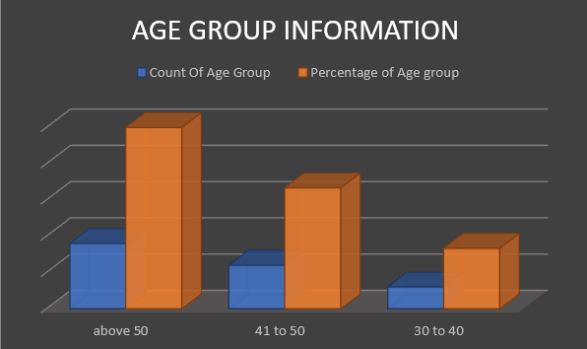
Age Group Information Of The Sample
16
The chart clearly illustrates that a significant portion of the sample comprises individuals aged above 50 years.
Following closely behind are the age groups ranging from 41 to 50 and 30 to 40 years old.
This distribution highlights the prominence of older age brackets within the sampled population, suggesting a notable representation of experienced educators in the study.

Slide 17
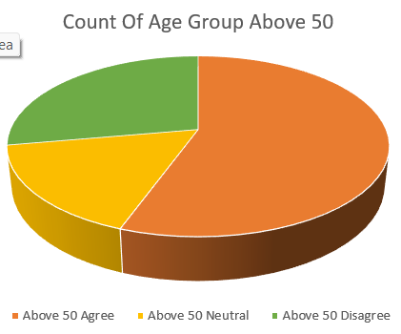
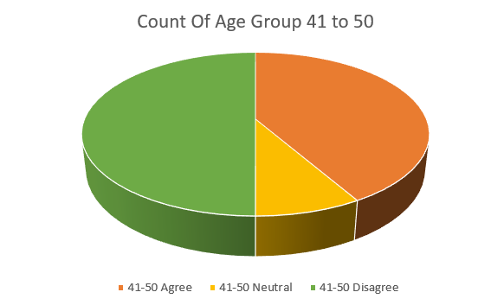
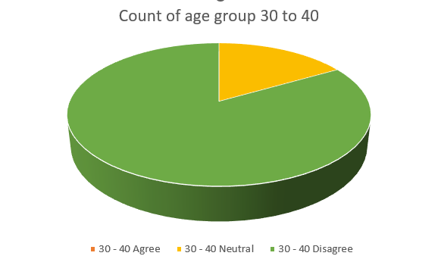
Analysis Based on the Age of the Respondents
17
From this chart, it's evident that most respondents in this age group agree with the hypothesis that integrating technology into teaching affects teachers' work-life balance.
The trend depicted in the image suggests that older individuals may encounter challenges in adapting to new technologies or altering established practices.
In this chart, it's noticeable that about half of the respondents disagree with the hypothesis.
This trend could suggest that younger age groups find it easier to use technology, potentially influencing their perceptions regarding its impact on work-life balance.
In this chart, over three-quarters of the respondents disagree with the hypothesis, while the remainder express neutral opinions.
This indicates that younger individuals, as observed in previous charts, may integrate technology more seamlessly, potentially avoiding disruptions to their work-life balance.

Slide 18
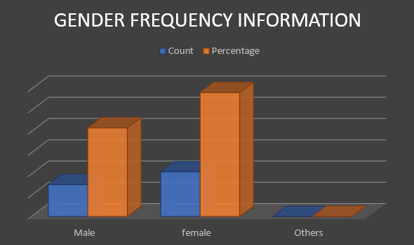
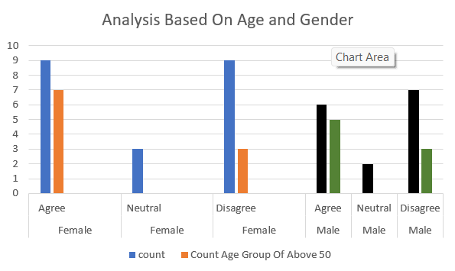
Gender Frequency Information Of The Sample
18
From the above bar diagram, it's noticeable that the frequency of females agreeing and disagreeing with the hypothesis is equal.
However, upon closer examination, among those who agreed, approximately two-thirds of the females are above 50 years old. Conversely, in the case of males, while the majority are disagreeing with the hypothesis overall, among those who agreed, most are also above 50 years old.
This observation strengthens the analysis that age indeed plays a significant role in the ability to integrate technology effectively.
The chart reveals a distribution where female respondents outnumber male respondents slightly, with no participants falling into the "others" category.
This observation suggests a gender distribution skewed towards females within the sampled population.

Slide 19
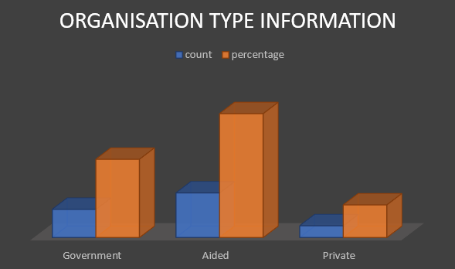
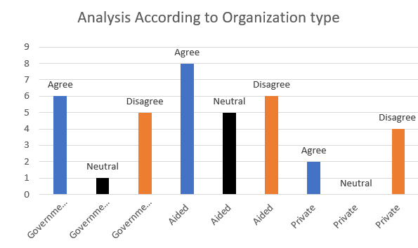
Analysis based on the Organization type that the teachers work.
19
The chart illustrates that within the sample, the majority of teachers work in aided schools or institutions, followed by those in government and private institutions.
This distribution highlights the prevalence of teachers within the aided sector, suggesting a noteworthy presence of educators in these types of educational establishments.
From this chart, it's evident that a significant portion of teachers from aided and government organizations or schools/institutions agree with the hypothesis that they are experiencing a lack of work-life balance due to technological integration.
Conversely, among private teachers, the majority disagree with the statement. This disparity suggests differing perspectives on the impact of technological integration on work-life balance across different types of educational institutions.

Slide 20
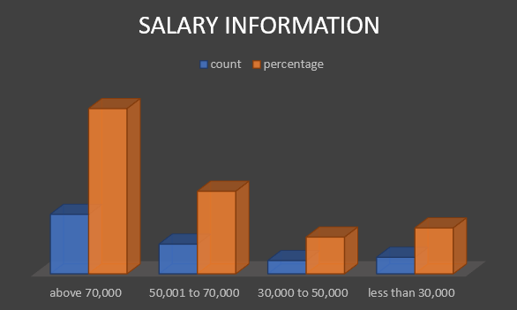
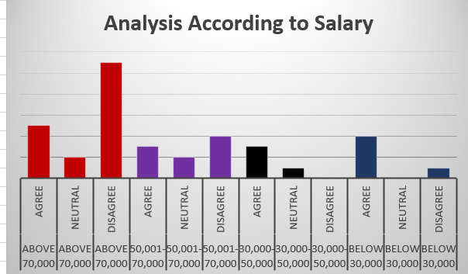
Analysis based on Salary of the Respondents
20
Analysis reveals that individuals earning salaries above 70,000, as well as those earning between 50,001 to 70,000, tend to disagree with the hypothesis, suggesting they are comfortable with the integration of technology.
Conversely, among individuals earning below these thresholds, there is a greater acceptance of the hypothesis, indicating potential concerns about the impact of technology integration on their work-life balance.
The figure indicates that the majority of individuals have a salary above 70,000, followed by those earning between 50,001 to 70,000, and then by those earning below 30,000 and 30,000 to 50,000.
This distribution highlights a prevalent concentration of respondents in higher salary brackets, with fewer individuals in lower income ranges.

Slide 21
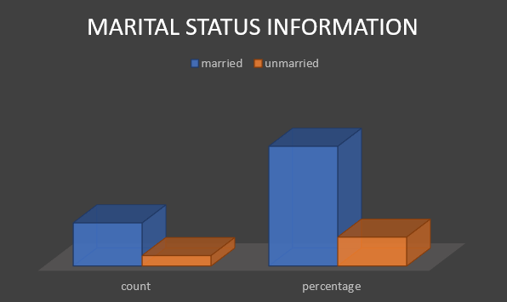
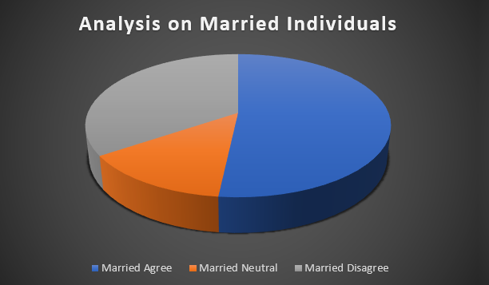
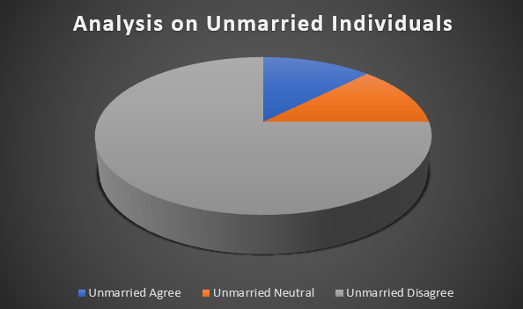
Analysis based on Marital Status of Respondents
21
In this chart, both the number and percentage of respondents who are married surpass those who are unmarried.
This observation indicates a higher representation of married individuals within the surveyed population.
Among married individuals, there appears to be a higher agreement with the hypothesis, possibly because they face challenges in allocating time for both work and family responsibilities.
Conversely, unmarried individuals tend to disagree with the hypothesis, suggesting they may have more flexibility in managing their work-life balance without the additional commitments of family life.

Slide 22
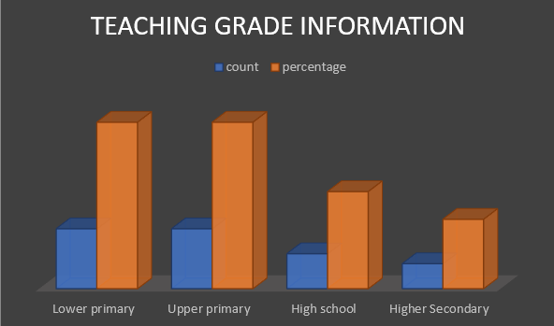
Grade Levels Handled by Teachers
22
Here we provide an overview of the distribution of teachers across different grade levels.
Interestingly, an equal number of teachers are observed in both the upper primary and lower primary sections, indicating a balanced representation.
Following this, we find a comparable presence of teachers in high school and higher secondary levels.
This distribution highlights the diversity of grade levels within the teaching population surveyed.

Slide 23
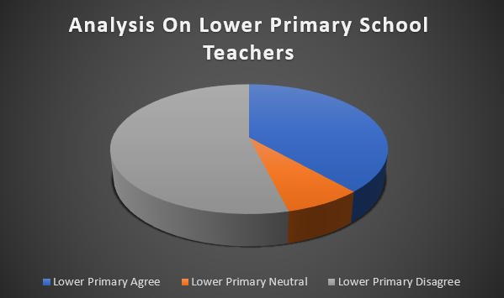
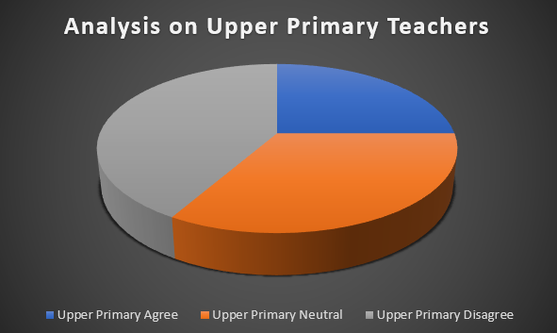
Analysis based on the Grade level handled by the teachers
23
For lower primary school teachers, the chart indicates that more than half of the respondents disagree with the hypothesis regarding work-life balance and technology integration.
This suggests a notable divergence of opinion among this group regarding the impact of technology on their professional and personal lives.
For upper primary school teachers, opinions appear to be more evenly divided.
While the numbers of respondents who disagree and those who are neutral are nearly equal, there are comparatively fewer individuals who agree with the hypothesis.
This balance of perspectives suggests a varied range of experiences and perceptions regarding the relationship between technology integration and work-life balance among this group of educators.

Slide 24
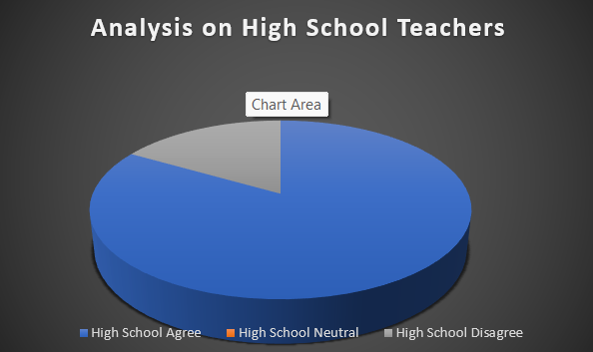
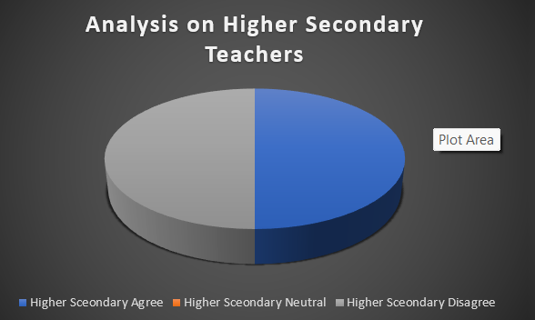
24
On the high school level, there is a noticeable majority of individuals agreeing with the hypothesis.
This trend might be attributed to the traditional teaching methods commonly employed in high schools, where technology integration may be less prevalent compared to other educational levels.
On the higher secondary level, we observe an equal number of individuals agreeing and disagreeing with the hypothesis.
This equilibrium could be attributed to the diverse teaching approaches and technological integration practices adopted across different higher secondary institutions, leading to varying perspectives among educators regarding the impact on work-life balance.

Slide 25
Conclusion
25
From the study, these conclusions can be drawn:
1) Age emerges as a significant factor, indicating that older teachers encounter more challenges in technological integration.
2) Gender-wise, it's evident that women, particularly older women, face more challenges in technological integration compared to men.
3) Regarding organizational type, teachers in private institutions demonstrate greater flexibility in integrating technology compared to those in aided and government institutions.
4) Higher salary levels correlate with a greater acceptance of technological integration among teachers.
5) Marital status impacts work-life balance, with married individuals experiencing more stress and difficulties in technological integration compared to unmarried individuals.
6) Grade level also plays a role, with lower primary and upper primary teachers exhibiting a more balanced work-life integration even with technological integration, in contrast to high school and higher secondary teachers.

Slide 26
Thank you
26

